Slide 1
Selected topics 1
Python
Dr: Nashwa Nageh

Slide 2
Agenda
Python os Module
Files Handling
Files Handling, write and append in file
Modules, Built In Modules
Random Module
Python Numpy library
Python Pands library
Python Math library

Slide 3
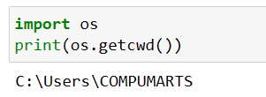
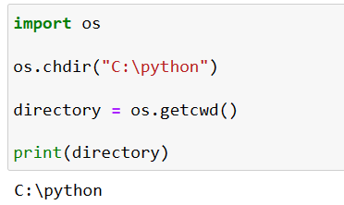
Python os Module
Python has a built-in os module with methods for interacting with the operating system, like creating files and directories, management of files and directories, input, output, environment variables, process management, etc.
Returns the current working directory
change the current directory to a subdirectory called “python" that is present inside the C directory.

Slide 4
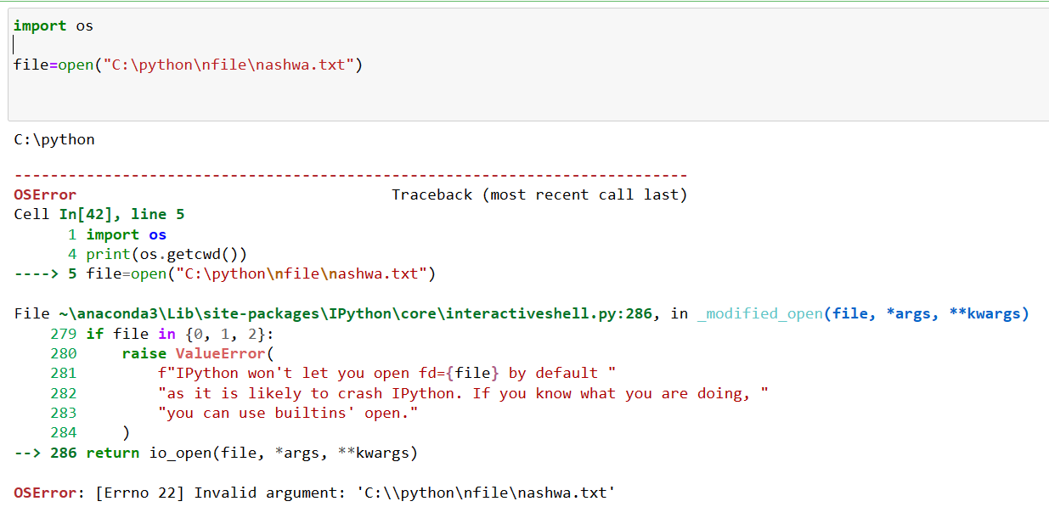
Error
Python read \n as Escape Sequence

Slide 5
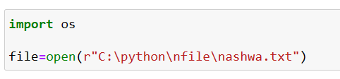
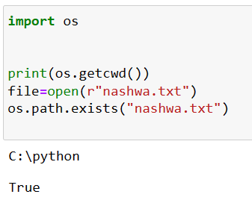
Python os Module
r Means 'Raw String'
Insert r before the file address, 'r' is a useful way to define a string where you need the backslash to be an actual backslash and not part of an escape code
exists(path) method returns True if the specified path exists

Slide 6
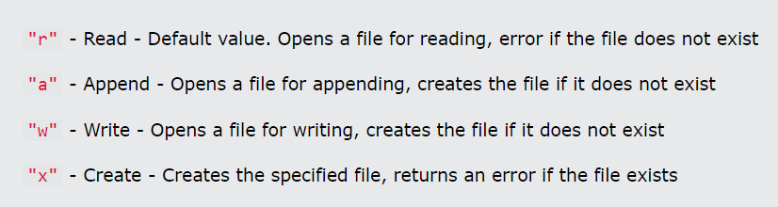
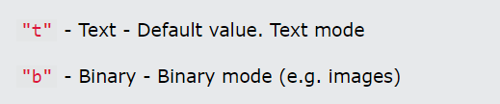
Files Handling
The key function for working with files in Python is the open() function.
The open() function takes two parameters; filename, and mode.
There are four different methods (modes) for opening a file:
In addition, you can specify if the file should be handled as binary or text mode

Slide 7


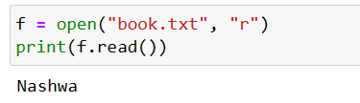
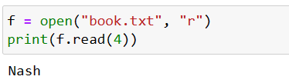
Files Handling
This code is the same as
Because "r" for read, and "t" for text are the default values, you do not need to specify them.
To open the file, use the built-in open() function.
The open() function returns a file object, which has a read() method for reading the content of the file:
Its default read all file contents
Read 4 characters from the file contents

Slide 8
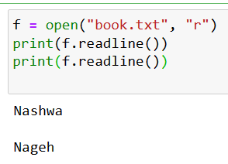
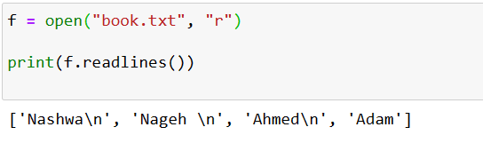

Files Handling
You can return one line by using the readline() method
readline() two times, you can read the two first lines, and so on
readlines() method return all lines in a list

Slide 9
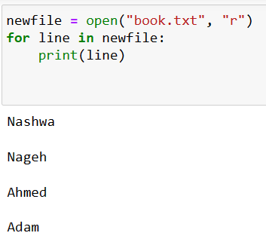
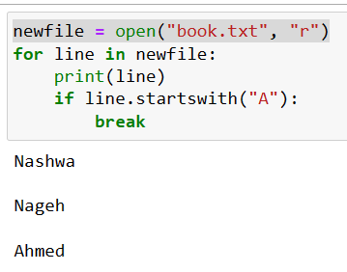

Files Handling
Display all file contents
The startswith() method returns True if a string starts with the specified prefix(string). If not, it returns False
Close the File

Slide 10

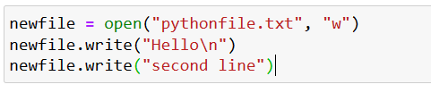
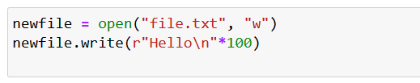
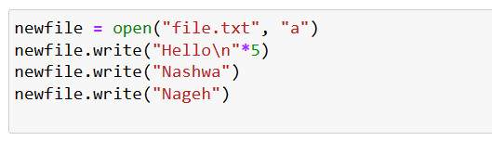
Files Handling, write and append in file
If the file not exist “w” write mode will be create it
Write() used to write in the file but take care it will remove all old content
Create new file and write “Hello” 100 times
Append the new line after the old ones

Slide 11
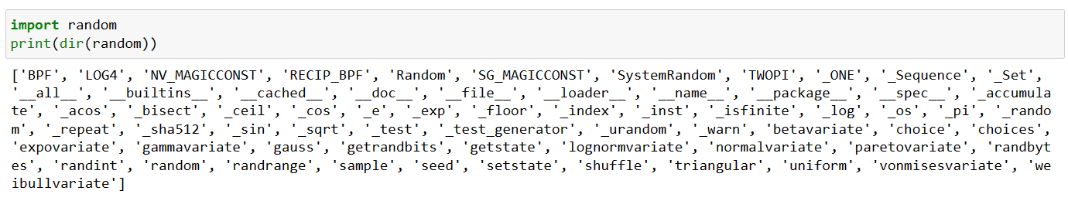
Modules, Built In Modules
What is a Module?
Consider a module to be the same as a code library.
A file containing a set of functions you want to include in your application.
How to Add a module to the project
Import module_name
For example, use random module
Using dir to print all information about random module (function and properties)

Slide 12

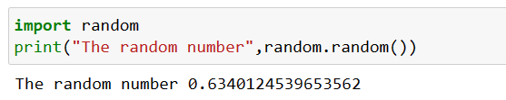
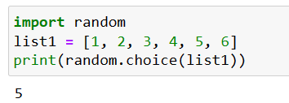
Random Module
Module_name Function_name
Random module has a function named random
Print a random number
random.choice() function. It prints a random element from the list, demonstrating how to pick a random item from a sequence in Python.

Slide 13

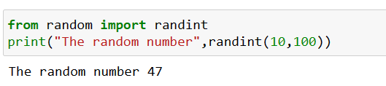
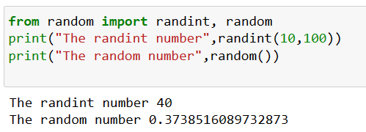
Import one or two function from module
From Module_name import Function_name
random.randint() method is used to generate random integers between the given range. Syntax: randint(start, end)
Import two function from random module

Slide 14
NumPy
NumPy stands for Numerical Python.
NumPy is a Python library used for working with arrays.
It also has functions for working in domain of linear algebra, fourier transform, and matrices.

Slide 15
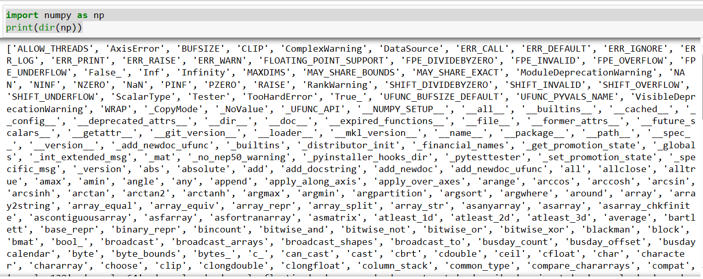
Numpy have many functions

Slide 16
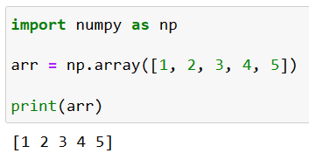
Python NumPy library
Import Numpy as np is a library that provides a set of high level functions and features for performing data analysis and manipulation. It enables you to process, analyze, manipulate, and visualize large amounts of data quickly and efficiently. With import numpy as np, you can perform array processing which allows you to efficiently operate on multiple elements of an array at once; access high performance computing solutions for complex calculations; and use multidimensional arrays & matrices with mathematical functions & algorithms for faster vectorized operations.

Slide 17
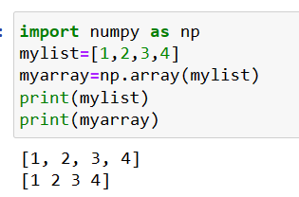
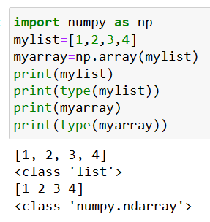
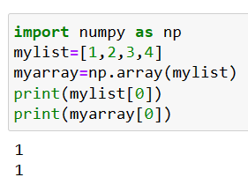
NumPy

Slide 18
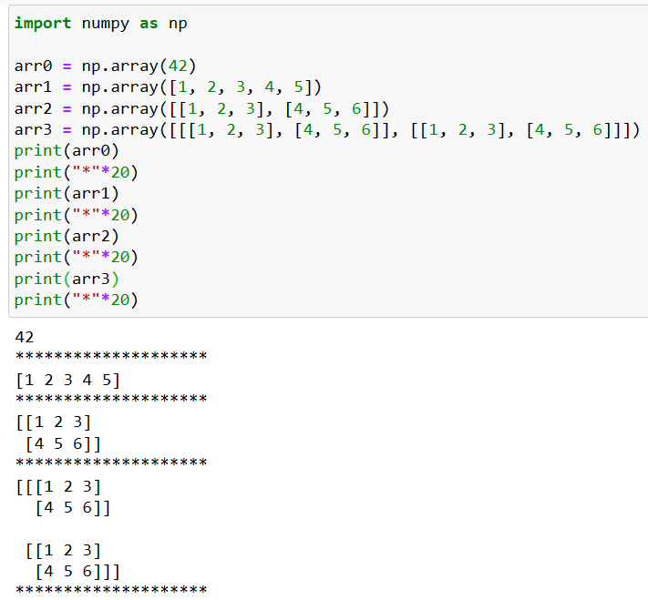
Dimensions in Arrays
0-D Arrays, are the elements in an array. Each value in an array is a 0-D array.
1-D Arrays, an array that has 0-D arrays as its elements is called uni-dimensional or 1-D array. These are the most common and basic arrays.
2-D Arrays, an array that has 1-D arrays as its elements is called a 2-D array. These are often used to represent matrix or 2nd order tensors.
3-D arrays, an array that has 2-D arrays (matrices) as its elements is called 3-D array. These are often used to represent a 3rd order tensor.

Slide 19
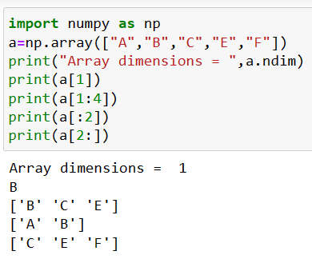
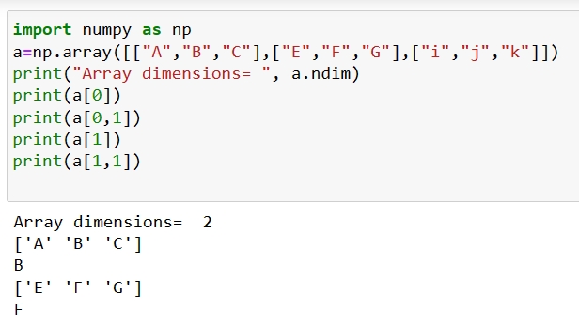
Array Slicing
Return the number of dimensions in arr.

Slide 20
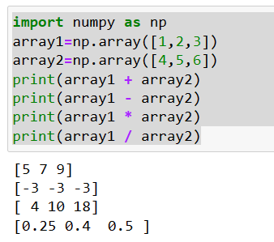
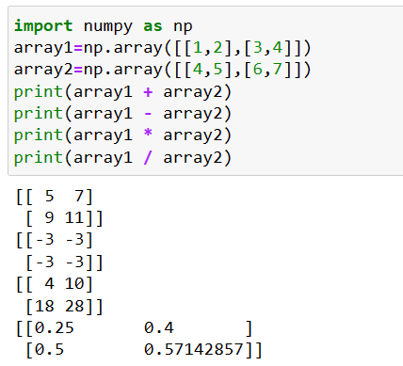
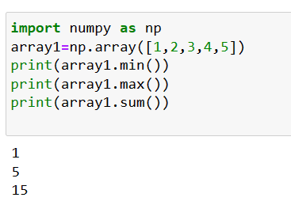
Numpy - Arithmetic And Useful Operations

Slide 21
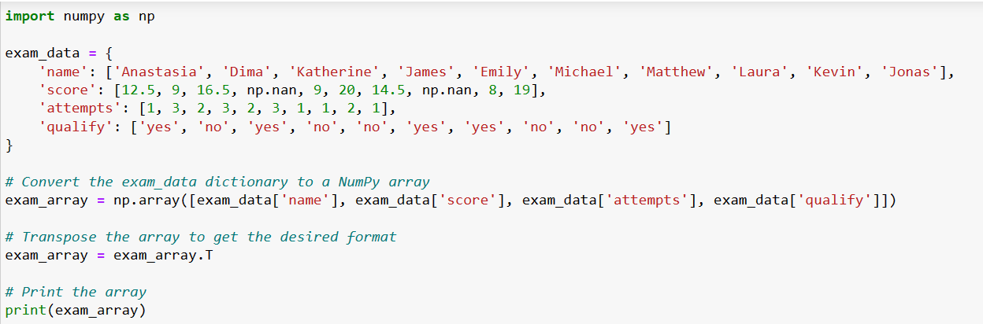
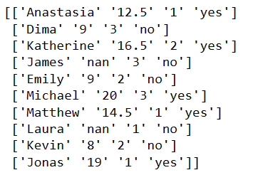
Example
output

Slide 22

Python Pandas library
The Pandas library is one of the most important Python libraries for reading and dealing with data, and creating its own graphs, It is an abbreviation of the words: Panel Data Analysis
What does import pandas as pd mean?
Import = “Bring this functionality or library to my python script”
Pandas = The library you want to import, in this case, it’s pandas
As = The python nomenclature for creating as alias. This is a fancy way of taking a long word and referencing it as a short word
pd = The standard short name for referencing pandas

Slide 23
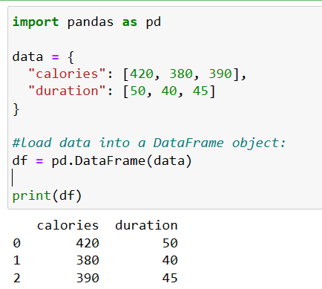
Python Pandas library
What is a DataFrame?
A Pandas DataFrame is a 2dimensional data structure, like a 2 dimensional array, or a table with rows and columns.

Slide 24
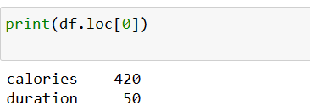
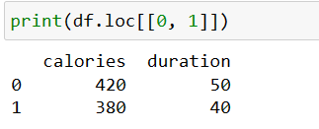
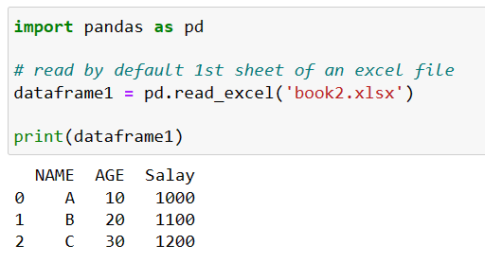
Python Pandas library
Pandas use the loc attribute to return one or more specified row(s)
Read excel file, and print the data

Slide 25
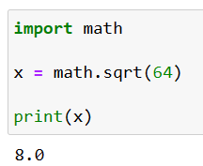
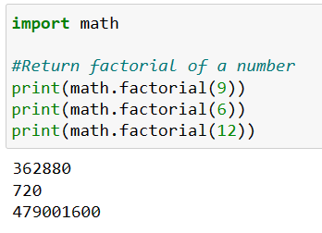
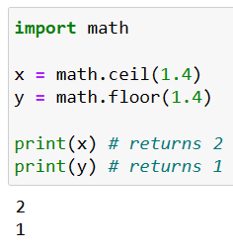
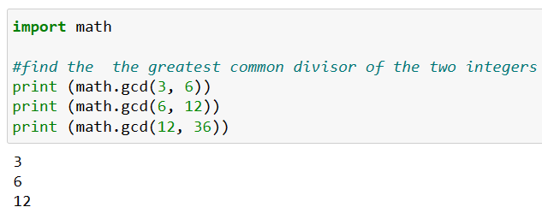
Python Math library
Python has also a built-in module called math, which extends the list of mathematical functions.

